Slide 1

NLP Albumentation
ISM 6930 – DATA EXPLORATION, VISUALIZATION & ANALYSIS
By
Shailendra Singh & Enock Chemochek

Slide 2

Agenda
INTRODUCTION
ROADMAP
EXPLORATION
BASE MODEL
NEXT STEPS

Slide 3

INTRODUCTION
More YELP Reviews?
More quality data = better models
Avoid data collection by generating synthetic data
Boost model metrics for YELP reviews analysis
Hypothesis: By creating more observations we can create better clustering models that can distinguish between groups better.

Slide 4

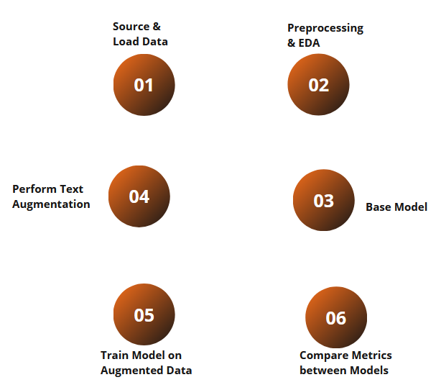
ROADMAP

Slide 5

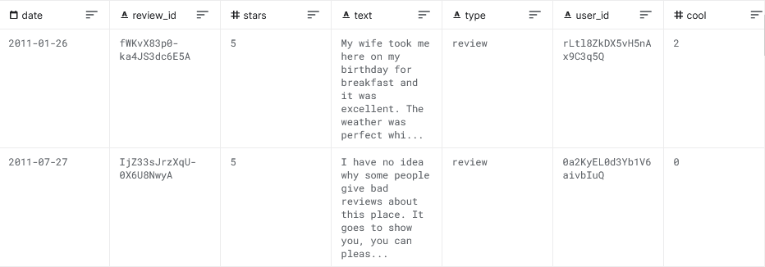
THE Data
Yelp Reviews

Slide 6
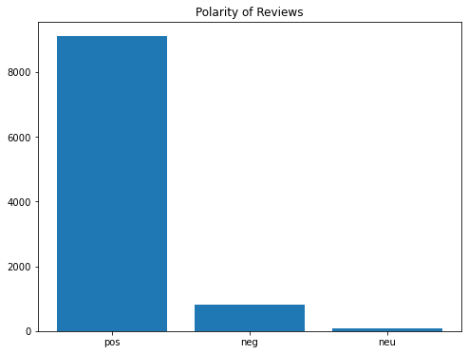
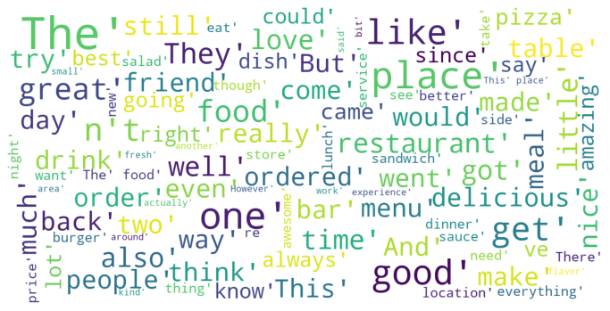
EXPLORATION
Overall sentiment
Word cloud (top 100 words)

Slide 7
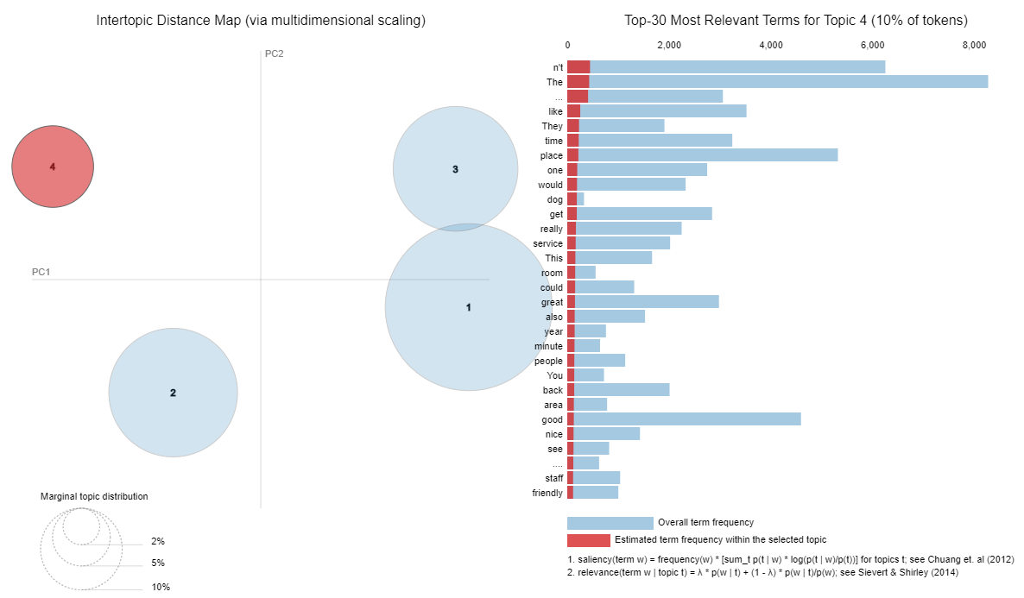
TOPICS

Slide 8
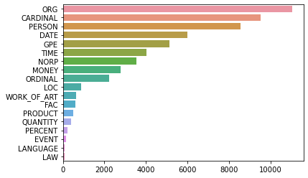
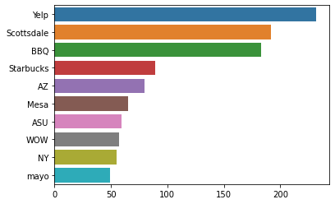
NER Distribution
Overall NER entities
Organizations

Slide 9
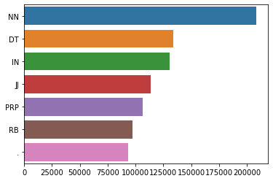
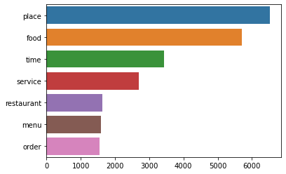
POS Distribution
POS tags overall
Nouns (NN)
NN: Noun, VB: Verb, JJ: Adjective, RB: Adverb, IN: Preposition, CC: Conjunction, PRP: Pronoun, INT: Interjection

Slide 10

What's Next
Finish the base clustering model
Continue on NLP-Aug Algorithmns/packages

Slide 11
THANK YOU

